Slide 2
Learning Objectives (1 of 2)
Describe the phases of the decision-making process in a typical organization and the types of decisions that are made
Describe a decision support system
Explain an executive information system’s importance in decision making
Describe group support systems, including groupware and electronic meeting systems

Slide 3
Learning Objectives (2 of 2)
Summarize the uses for a geographic information system
Describe the guidelines for designing a management support system

Slide 4
Types of Decisions in an Organization (1 of 4)
Structured decisions
Can be automated because a well-defined standard operating procedure exists for these types of decisions
Known as programmable tasks
Semistructured decisions
Include a structured aspect that benefits from information retrieval, analytical models, and information systems technology

Slide 5
Types of Decisions in an Organization (2 of 4)
Unstructured decisions
One-time decisions with no standard operating procedure
Decision maker’s intuition plays an important role as information technology offers less support for the decisions

Slide 6
Types of Decisions in an Organization (3 of 4)
Challenges in semistructured and unstructured decisions
Multiple criteria and users have to choose between conflicting objectives

Slide 7
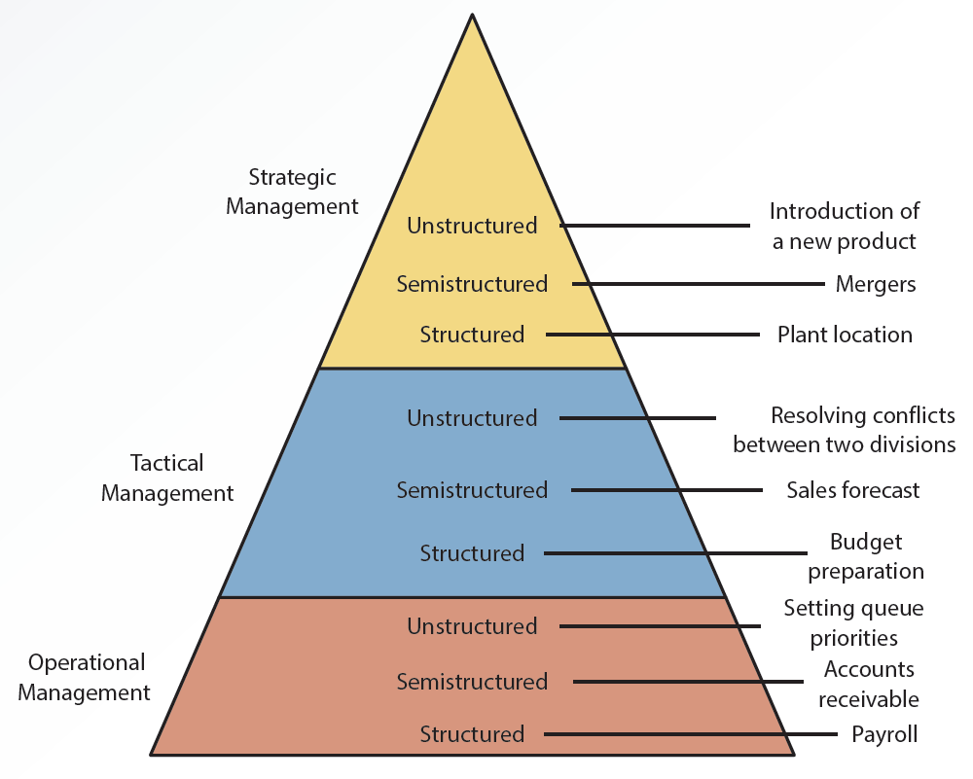
12.1 Organizational Levels and Types of Decisions

Slide 8
Types of Decisions in an Organization (4 of 4)
Management support systems (MSSs)
Different types of information systems that have been developed to support certain aspects and types of decisions
Each type is designed with unique goals and objectives

Slide 9
Phases of Decision Making
Herbert Simon defined three phases
Intelligence phase
Design phase
Choice phase
Implementation phase

Slide 10
Intelligence Phase
Decision maker examines the organization’s environment for conditions that need decisions
Data is collected from a variety of sources and processed
Allows decision maker to discover ways to approach the problem

Slide 11
Design Phase
Defines the criteria for a decision
Generates alternatives for meeting the criteria
Defines associations between the criteria and the alternatives
Requires understanding how each alternative affects the criteria
Information technology does not support this phase of decision making

Slide 12
Choice Phase
Selecting the best and most effective course of action is from the alternatives
Analyzing each alternative and its relationship to the criteria to determine whether it is feasible
Decision support system (DSS)
Helps sort through possible solutions to choose the best one for the organization
Includes tools for calculating cost-benefit ratios

Slide 13
Implementation Phase
Organization devises a plan for carrying out the alternative selected in the choice phase and obtains the resources to implement the plan
DSS does a follow-up assessment on how well a solution is performing

Slide 14
Decision Support Systems (1 of 2)
Decision support systems (DSS): interactive information system designed to assist decision makers in an organization
Hardware
Software
Data
Mathematical and statistical models

Slide 15
Decision Support Systems (2 of 2)
Requirements of decision support systems
Be interactive
Incorporate the human element as well as hardware and software
Use internal and external data
Include mathematical and statistical models
Support decision makers at all levels
Emphasize semistructured and unstructured tasks

Slide 16
Components of Decision Support Systems (1 of 2)
Database
Includes internal and external data and a database management system (DBMS)
Enables a DSS to perform data analysis

Slide 17
Components of Decision Support Systems (2 of 2)
Model base
Includes mathematical and statistical models
Enable a DSS to analyze information
User interface component
Allow users to access the DSS

Slide 18
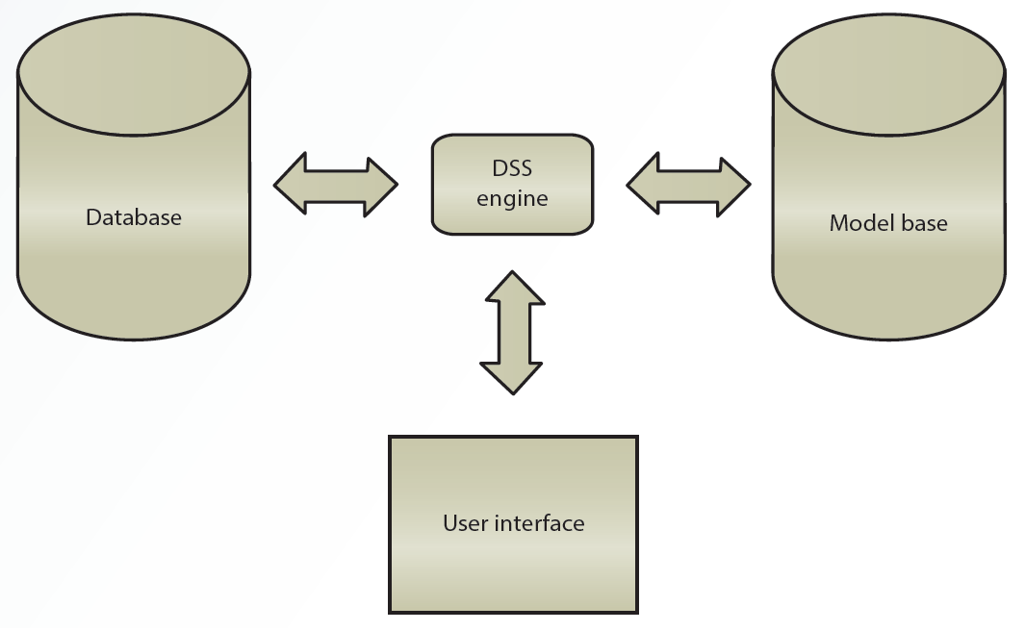
12.2 Components of a DSS

Slide 19
DSS Capabilities
DSS includes features to support decision making
What-if analysis
Goal-seeking
Sensitivity and exception reporting analysis
Other capabilities
Graphical analysis, forecasting, simulation, statistical analysis, and modeling analysis

Slide 20
Roles in the DSS Environment (1 of 3)
Users
Crucial because they use the DSS
Include department or organizational units in addition to people
Managerial designer
Defines the management issues in designing and using a DSS
Issues are related to management’s goals and needs

Slide 21
Roles in the DSS Environment (2 of 3)
Technical designer
Focuses on how the DSS is implemented
Addresses questions
Data storage
File structure
User access
Response time
Security measures

Slide 22
Roles in the DSS Environment (3 of 3)
Model builder
Liaison between users and designers
Responsible for supplying information
What the model does
What data inputs the model accepts
How the model’s output should be interpreted
What assumptions go into creating and using the model

Slide 23
Costs and Benefits of Decision Support Systems
Benefits
Increase in the number of alternatives examined
Fast response to unexpected situations
Ability to make one-of-a-kind decisions
New insights and learning
Improved communication, control, and decisions
Cost and time savings
Effective teamwork and use of data resources

Slide 24
Executive Information Systems (1 of 2)
Executive information systems (EISs): interactive information systems
Give executives easy access to internal and external data
Branch of DSSs
Include drill-down features and digital dashboard
Designers should focus on simplicity when developing a user interface

Slide 25
Executive Information Systems (2 of 2)
Adding features increases ease of use
Require access to both internal and external data
Must collect data related to an organization’s critical success factors
Include a digital dashboard: integrates information from multiple sources and presents it in a unified, understandable format

Slide 26
Reasons for Using EISs
Provide managers with analytical and decision-making tools
Include graphical representations of data that help executives make critical decisions
Used by executives to share information with others quickly and easily
Used by managers to improve efficiency and effectiveness of decision making

Slide 27
Avoiding Failure in Design and Use of EISs (1 of 2)
Organizational resistance to the project
Perception that the project is unimportant
Lack of interest or commitment from management
Inability to define objectives and information requirements clearly
System’s objectives are not linked to factors critical to the organization’s success

Slide 28
Avoiding Failure in Design and Use of EISs (2 of 2)
Project’s costs cannot be justified
Developing applications takes too much time, or the system is too complicated
Vendor support has been discontinued
Senior executives lack computer proficiency
Unlikely to use systems that need training
Lack of understanding about what executives’ work involves

Slide 29
EIS Packages and Tools (1 of 2)
EISs are generally designed with two or three components
Administrative module for managing data access
Builder module for developers to configure data mapping and screen sequencing
Runtime module for using the system

Slide 30
EIS Packages and Tools (2 of 2)
Tasks performed by managers using EIS
Tracking performance
Flagging exceptions
Ranking
Comparing
Spotting trends
Investigating/exploring

Slide 31
Group Support Systems (1 of 3)
Group support systems (GSSs): assist decision makers working in groups
Use computer and communication technologies to formulate, process, and implement a decision-making task
Help overcome limitations of group interactions
Reduce communication barriers
Introduce order and efficiency into situations that are unsystematic and inefficient

Slide 32
Group Support Systems (2 of 3)
Success depends on:
Matching the GSS’s level and sophistication to the group’s size and the scope of the task
Providing supportive management that is willing to champion using a GSS in the organization

Slide 33
Group Support Systems (3 of 3)
Useful for:
Committees
Review panels
Board meetings
Task forces
Decision-making sessions that require input from several decision makers

Slide 34
Groupware (1 of 2)
Assists groups in communicating, collaborating, and coordinating their activities
Collection of applications that supports decision makers by providing access to a shared environment and information

Slide 35
Groupware (2 of 2)
Capabilities of groupware
Audio and video conferencing
Automated appointment books
Brainstorming
Database access
E-mail and online chat
Scheduling and to-do lists
Workflow automation

Slide 36
Electronic Meeting Systems
Enable decision makers in different locations to participate in a group decision-making process
Features
Real-time computer conferencing
Video teleconferencing
Desktop conferencing

Slide 37
Advantages and Disadvantages of GSSs (1 of 2)
Advantages
Costs and stress are reduced; infrequent travel by decision makers
Increased time to talk with each other and solve problems; decision makers do not travel long distances
Decreased shyness
Increasing collaboration improves the effectiveness of decision makers

Slide 38
Advantages and Disadvantages of GSSs (2 of 2)
Disadvantages
Lack of the human touch
Unnecessary meetings
Security problems

Slide 39
Geographic Information Systems (1 of 2)
Geographic information systems (GISs)
Capture, store, process, and display geographic information
Shows location of all city streetlights on a map
Uses spatial and nonspatial data for storing complex geographic objects
Points
Lines
Areas

Slide 40
Geographic Information Systems (2 of 2)
Example: Google Maps
Interactive GIS that identifies routes from start to destination
User-friendly interface that helps one visualize the route

Slide 41
GIS Applications
Categories
Education planning
Urban planning
Government
Insurance
Marketing
Real estate
Transportation and logistics

Slide 42
Guidelines for Designing a Management Support System (1 of 2)
Important factors
Support from the top management
Objectives and benefits clearly defined
Identifying executives’ information needs
Keeping lines of communication open
System’s complexity hidden and interface kept simple

Slide 43
Guidelines for Designing a Management Support System (2 of 2)
Maintaining consistency in design
Designing a flexible system
Making sure response time is fast

Slide 44
Summary (1 of 2)
Different types of information systems are developed to support certain aspects and types of decisions
Decision support system (DSS) is designed to assist decision makers in an organization
EIS designers should focus on simplicity when developing a user interface

Slide 45
Summary (2 of 2)
GIS uses spatial and nonspatial data and techniques for storing coordinates of complex geographic objects

